Slide 1
Do not delete this slide.
This slide is designed so that you can copy the prompt box you need and insert it into your slides.
This slide is hidden and will not be included when presenting your lesson.
TRACK WITH ME
VOCABULARY
1 -
HINT
Students, remember….
CHECK FOR UNDERSTANDING
READ WITH ME
TEACHER CUE
MAKE THE CONNECTION
Students, you already know….
EXTENSION
GESTURE WITH ME

Slide 2
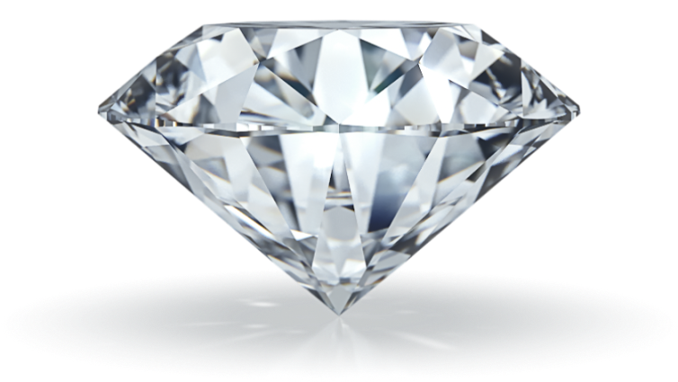
We will distinguish between common pure substances and mixtures.
Pure substances are substances₁ that have nothing else mixed with them.
CHECK FOR UNDERSTANDING
Provide 1 example and non-example of pure substance.
Example | Non-Example
Pure sugar | Sea water
Pure water | Tap water
Salt | Orange Juice
Gold | Oil and water
Diamond | Salad
VOCABULARY
1 - material with traits or qualities

Slide 3
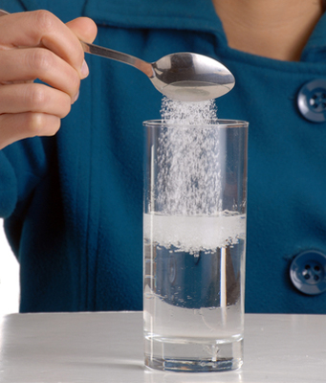
We will distinguish between common pure substances and mixtures.
CHECK FOR UNDERSTANDING
In the picture below, sugar is being mixed into water. Is this a mixture?
Mixtures are substances made from two or more pure substances that have been mixed together.
For it to be called a mixture you must be able to separate it again.
Some techniques to separate mixtures:
Decantation
Magnetic Separation
Filtering
Evaporation

Slide 4
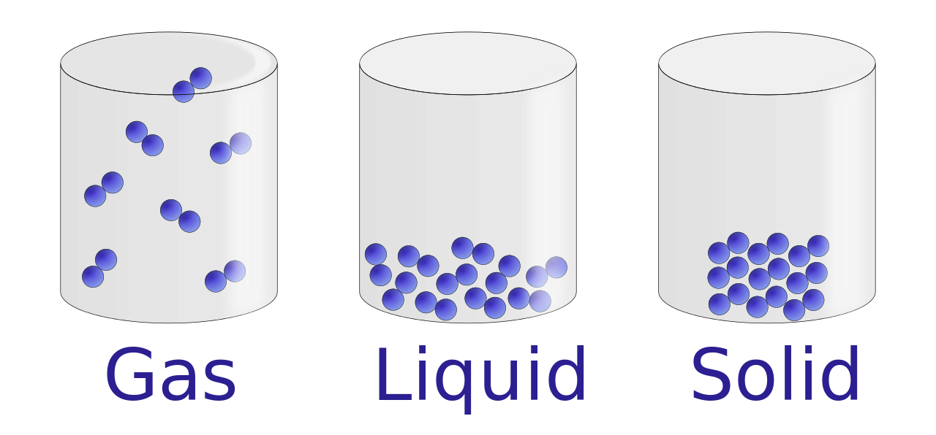
We will describe states of matter using the particle model
Everything that takes up space is made of matter.
Matter is made up of tiny particles too small to be seen.
Particles are small portions of matter.
Particles act differently if matter is a solid, liquid or gas. We call these the states of matter.
These particles always have energy and are moving. If we add energy they speed up and if we take energy away they slow down.
CHECK FOR UNDERSTANDING
What are the three states of matter?

Slide 5
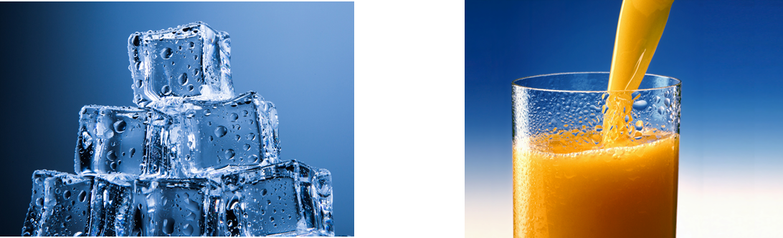
We will describe states of matter using the particle model
Solids
The particles in solids are packed closely together.
The particles have strong bonds₁ between them. This is why solids have a fixed shape and volume.
The particles stay in the same position but vibrate.
Example Non-Example
VOCABULARY
1 - forces of attraction between particles

Slide 6
We will describe states of matter using the particle model
Liquids
The particles in liquids are still packed closely together. The particles are more loosely bonded than solids.
The loose bonding allows particles to move over each other allowing the liquid to flow, drip and fill the bottom of the container it is in.
Liquids have no fixed shape but have a fixed volume.
CHECK FOR UNDERSTANDING
Why do solids have a fixed shape but liquids do not?

Slide 7
We will describe states of matter using the particle model
Gases
The particles in gases are spread far apart and have no bonds₁.
The particles move fast and in straight lines until they hit something. This is why they fill their containers. Particles are so spread apart that gases are often invisible.
Gases have no fixed shape or volume.
CHECK FOR UNDERSTANDING
Why do solids have a fixed shape but liquids do not?
VOCABULARY
1 - forces of attraction between particles

Slide 8
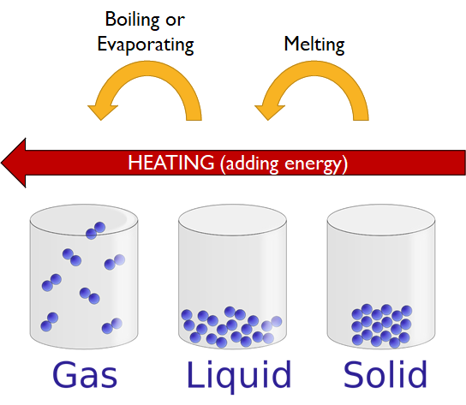
We will describe states of matter using the particle model
Heating
Melting occurs when solids are heated and become a liquid.
Boiling occurs when liquids are heated and become a gas.
The temperatures that this happens are called melting points and boiling points.
Evaporation is similar to boiling as liquids become gases, but this can happen at any temperature and is usually slow.
CHECK FOR UNDERSTANDING
Are particles speeding up or slowing down when heated?

Slide 9
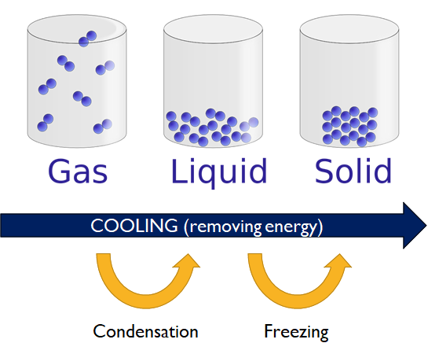
We will describe states of matter using the particle model
Cooling
Condensation occurs when a gas loses heat and changes into a liquid.
Freezing occurs when a liquid loses heat and changes into a solid.
Different substances have different temperatures that they freeze at. This is called a freezing point.
CHECK FOR UNDERSTANDING
Are particles speeding up or slowing down when cooled?

Slide 10
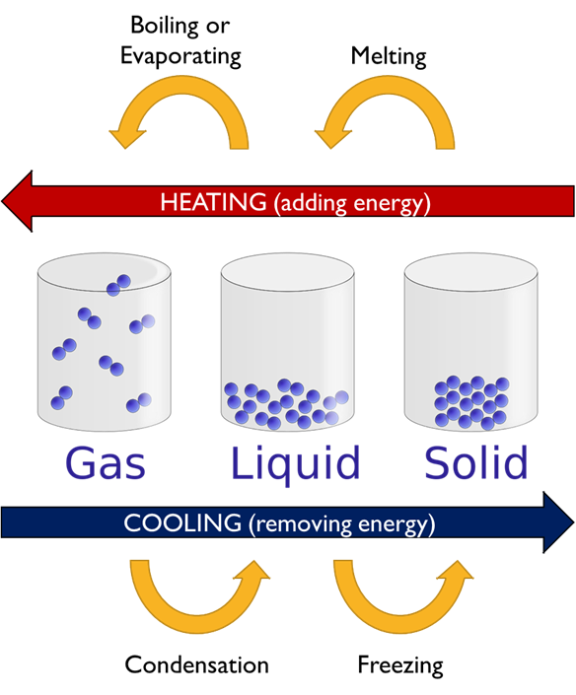
We will describe states of matter using the particle model
CHECK FOR UNDERSTANDING
Which state of matter do particles have the most energy?
CHECK FOR UNDERSTANDING
Which state of matter fills the bottom of the container their in?

Slide 11
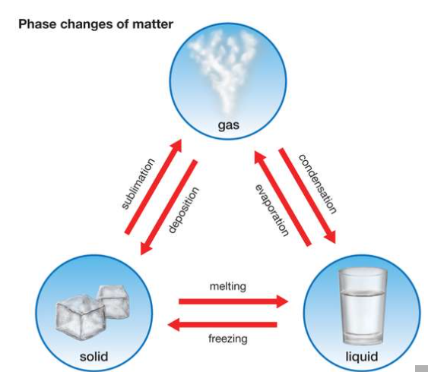

Name the processes using the word banks below:
Sublimation Condensation
Evaporation Freezing
Melting Deposition
We will describe states of matter using the particle model
A
C
B
D
E
F
Notes:
https://www.youtube.com/watch?v=xYU7RSoOZ0U

Slide 12
Particles are very packed together.
Particles are close together.
Particles are far apart.
Quality | Solids | Liquids | Gases
Distance | Particles are close together. | Particles are close to each other. | Particles are far apart.
Motion | Particles move in one spot. | Particles move easily. | Particles move quickly.
Hardness | The matter is hard to break apart. | The matter is easy to break apart. | The matter can expand or be compressed₁.
Shape | Matter holds its own shape. | The matter cannot hold its own shape. | Particles expand to fill all the space of any container.

Slide 13
Particles are very close together.
Particles move in one spot.
Particles move easily.
Quality | Solids | Liquids | Gases
Distance | Particles are close together. | Particles are close to each other. | Particles are far apart.
Motion | Particles move in one spot. | Particles move easily. | Particles move quickly.
Hardness | The matter is hard to break apart. | The matter is easy to break apart. | The matter can expand or be compressed₁.
Shape | Matter holds its own shape. | The matter cannot hold its own shape. | Particles expand to fill all the space of any container.

Slide 14
The matter can expand or be compressed.
The matter is hard to break apart.
The matter is easy to break apart.
Quality | Solids | Liquids | Gases
Distance | Particles are close together. | Particles are close to each other. | Particles are far apart.
Motion | Particles move in one spot. | Particles move easily. | Particles move quickly.
Hardness | The matter is hard to break apart. | The matter is easy to break apart. | The matter can expand or be compressed₁.
Shape | Matter holds its own shape. | The matter cannot hold its own shape. | Particles expand to fill all the space of any container.

Slide 15
Particles expand to fill all the space of any container.
Matter holds its own shape.
The matter cannot hold its own shape.
Quality | Solids | Liquids | Gases
Distance | Particles are close together. | Particles are close to each other. | Particles are far apart.
Motion | Particles move in one spot. | Particles move easily. | Particles move quickly.
Hardness | The matter is hard to break apart. | The matter is easy to break apart. | The matter can expand or be compressed₁.
Shape | Matter holds its own shape. | The matter cannot hold its own shape. | Particles expand to fill all the space of any container.

Slide 16
Particles act differently if matter is a solid, liquid or gas.
Quality | Solids | Liquids | Gases
Distance | Particles are close together. | Particles are close to each other. | Particles are far apart.
Motion | Particles move in one spot. | Particles move easily. | Particles move quickly.
Hardness | The matter is hard to break apart. | The matter is easy to break apart. | The matter can expand or be compressed₁.
Shape | Matter holds its own shape. | The matter cannot hold its own shape. | Particles expand to fill all the space of any container.

Slide 17
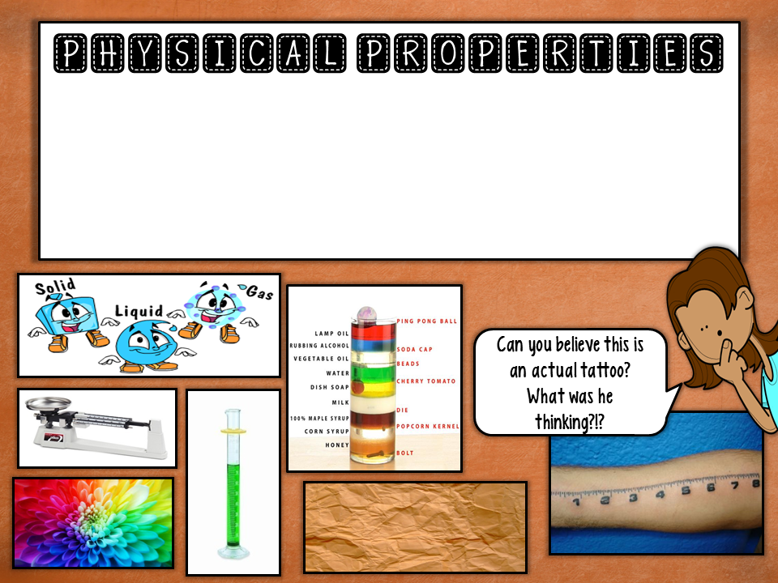
Can be observed or measured without changing a substance into another substance
Are observed when using one or more of your 5 senses: touching, seeing, smelling, tasting, and hearing

Slide 18
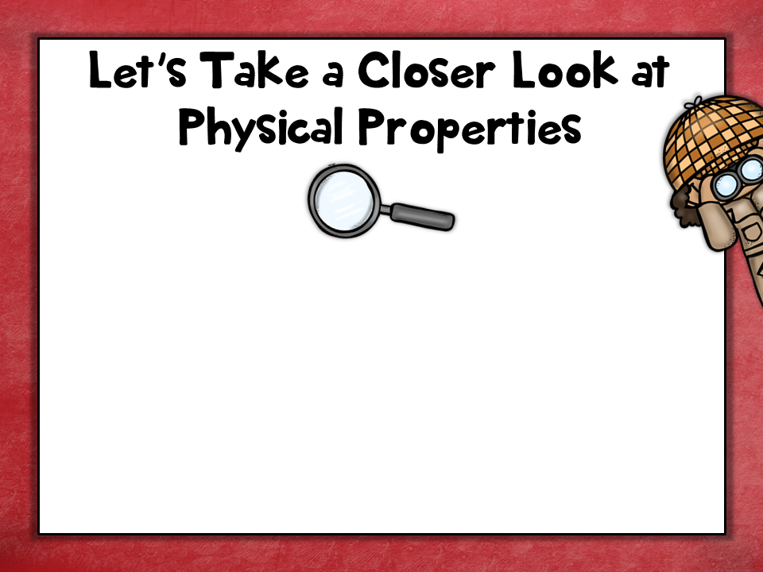
Some physical properties include things you are already familiar with: color, odor, shape, state (solid, liquid, gas), density (mass per unit of volume)
luster, malleability, ductility, solubility, conductivity, hardness

Slide 19

Luster is how shiny a substance is.
Some examples include: glass, diamonds, & metals

Slide 20
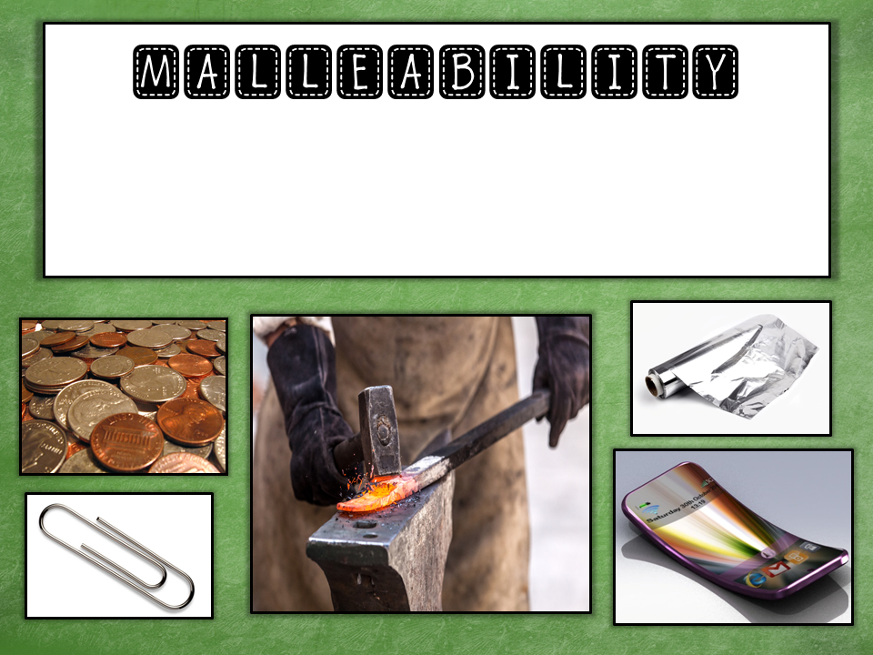
Malleability is the ability of a material to bend or be hammered into other shapes without breaking.

Slide 21
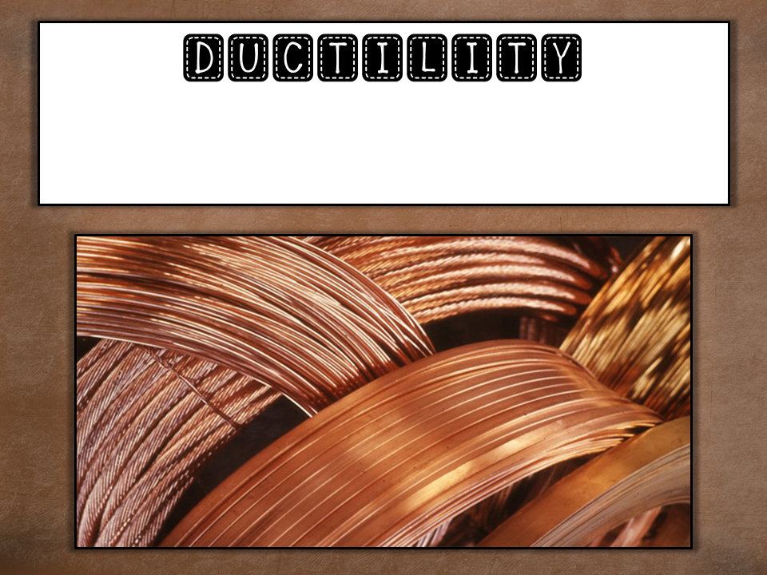
Ductility is the ability of a substance to be drawn into thin wires.

Slide 22
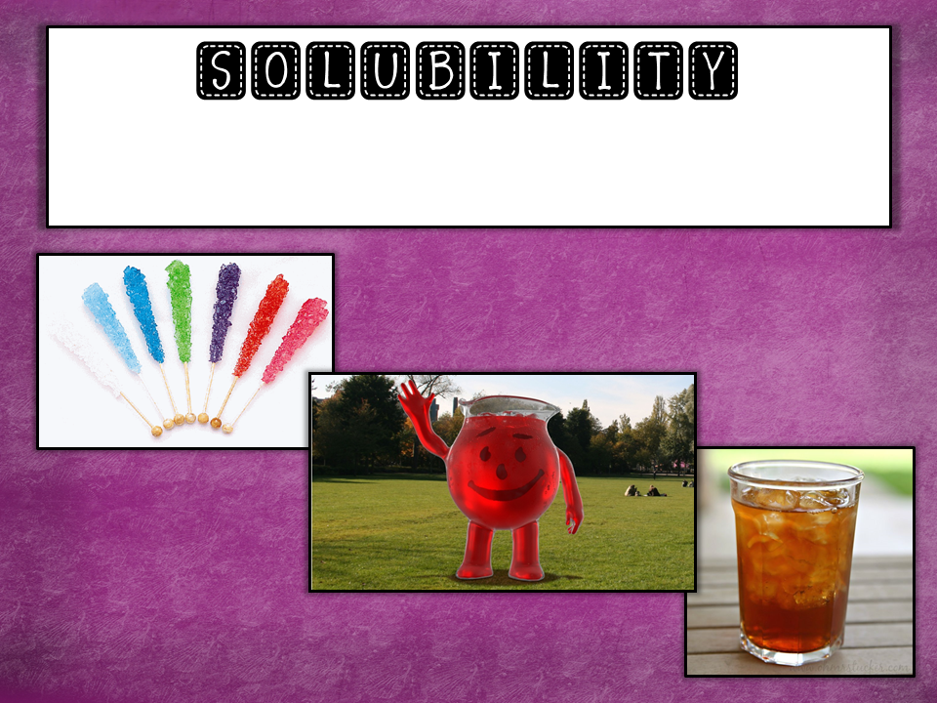
Solubility is the ability of a substance to dissolve in a liquid.

Slide 23
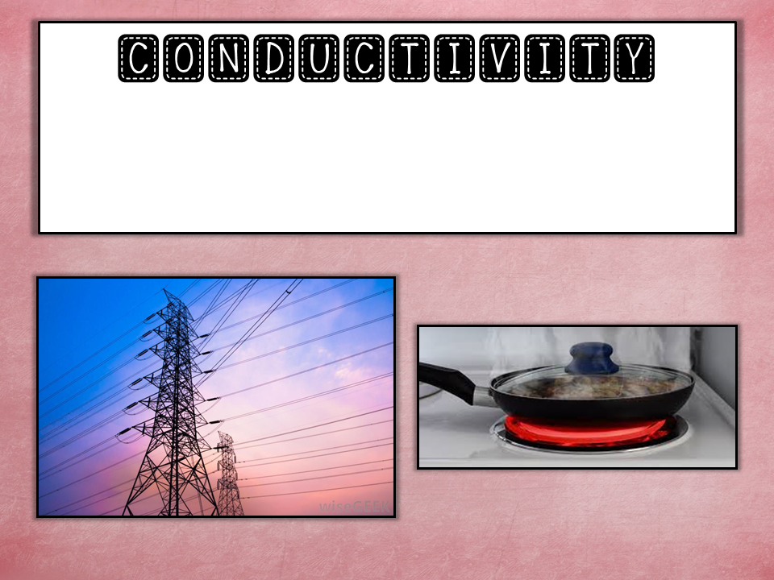
Conductivity is the ability to pass electricity or heat through a substance.

Slide 24
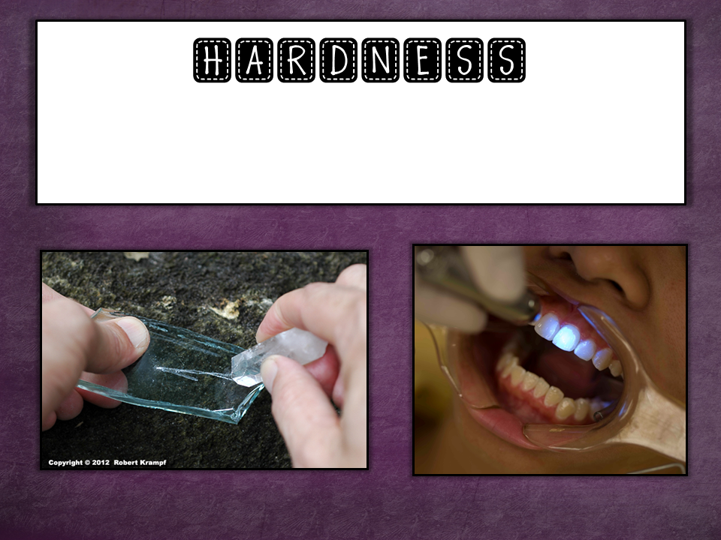
Hardness is a resistance to being scratched or dented.

Slide 25
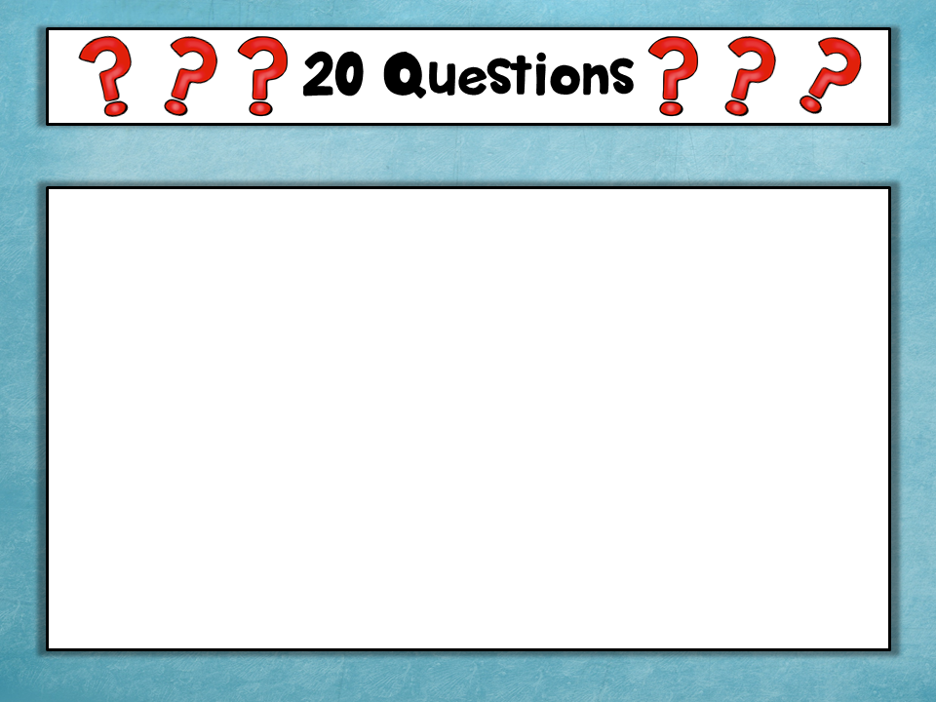
A volunteer is going to come up to the front of the room & try to determine the identity of an object by asking questions about that object.
The rest of you can only respond with
YES or NO!!!
If the volunteer can identify the object after asking 20 (or fewer) questions
***Volunteers – you will want to ask questions about the physical properties of the object.
Notes:
For this activity, I usually take in cards from the “Headbanz” game, but you can just go to Google & print off any pictures you would like. I have one volunteer at a time hold a card in front of his/her forehead so everyone else can see & then he/she asks questions to determine what is on his/her card. For middle school students I use “silly” cards such as diaper, boxer shorts, deodorant, etc.
*I only spend about 5 minutes on this activity & then move on. The kids LOVE this!*

Slide 26
Chemical Properties
Describe a substance based on the ability to change into a new substance with different properties.
A chemical property can only be observed by actually changing the identity of the substance.
Example:
A piece of paper burns and turns into ash.
The chemical property of the paper is that it is flammable.

Slide 27
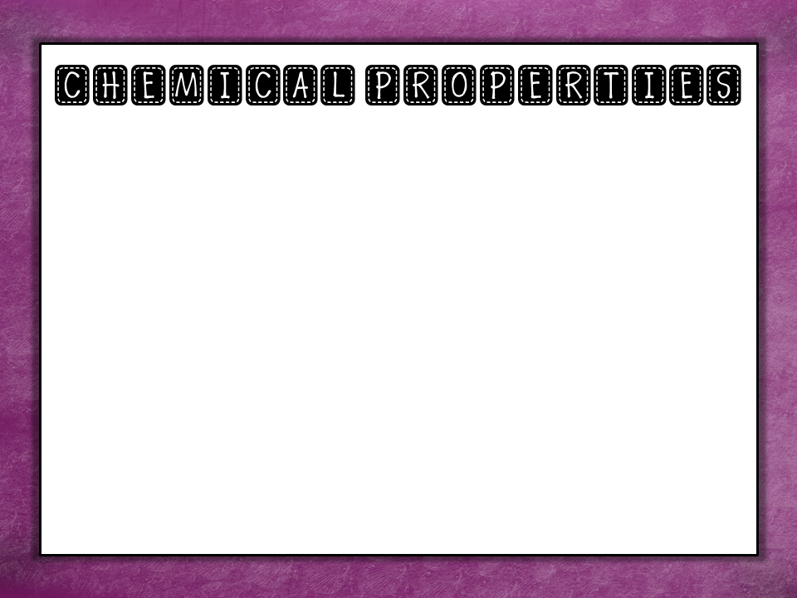
Flammability: The ability to catch on fire
Oxidation: The ability to react with oxygen
Toxicity: The ability to be poisonous
Sensitivity to Light: The ability to change when exposed to light
Reactivity with water: The ability to react with water

Slide 28
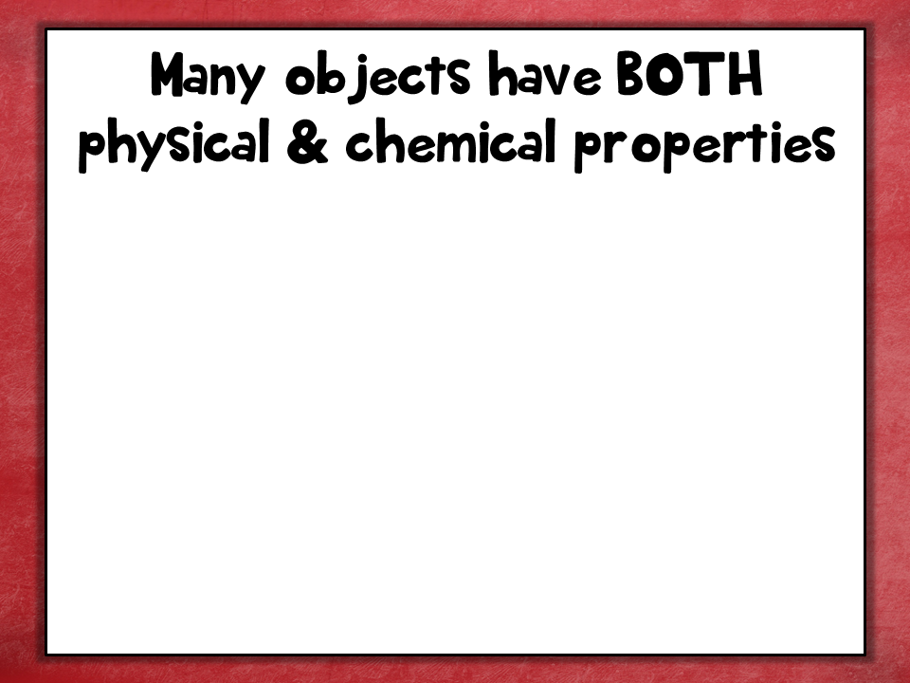
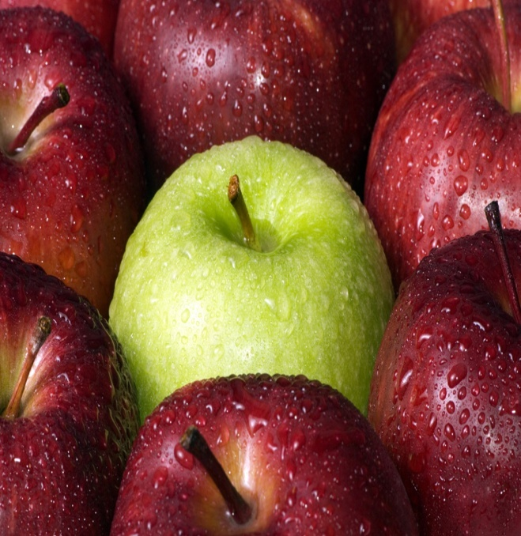
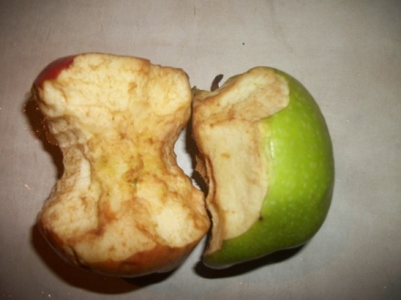
Physical Properties
red/green
shiny
round
smooth
Chemical Properties
oxidation – can react with oxygen & turn brown
Notes:
Give the students a minute or 2 to list as many physical & chemical properties as they can. Have the students share their answers with the class.

Slide 29
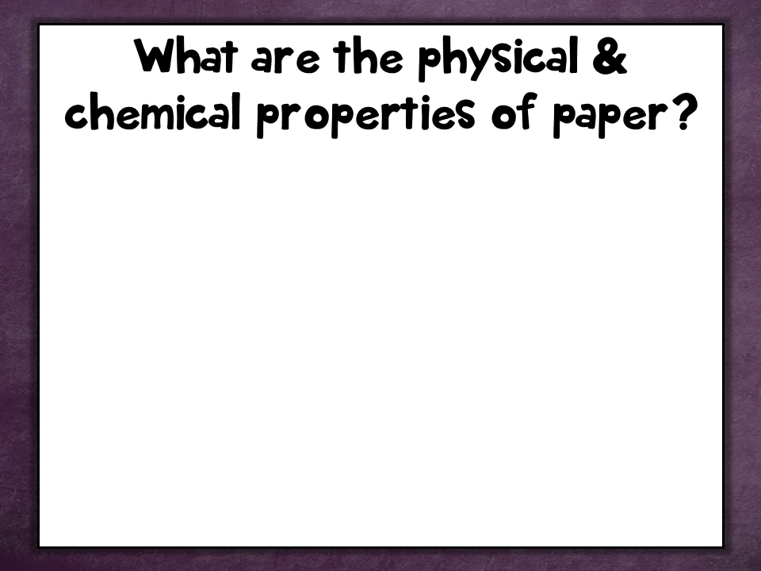

Physical Properties
smooth
thin
dull
flat
Chemical Properties
sensitivity to light (you can see this with old books & newspapers)
flammable

Slide 30
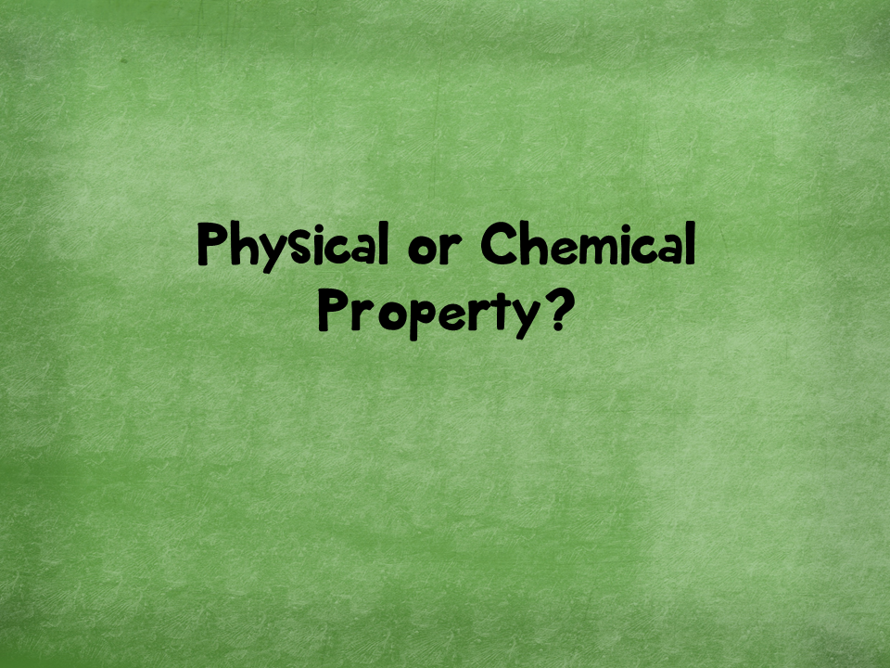

Slide 31
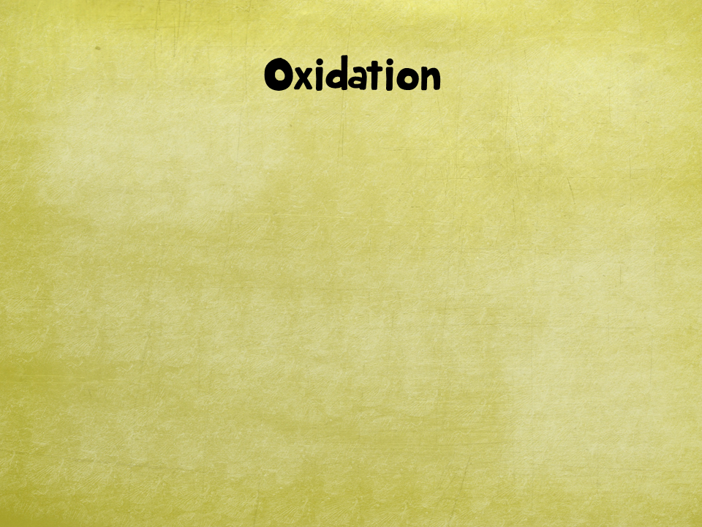

Chemical Property
Notes:
Chemical property

Slide 32


Physical Property
Notes:
Physical property

Slide 33
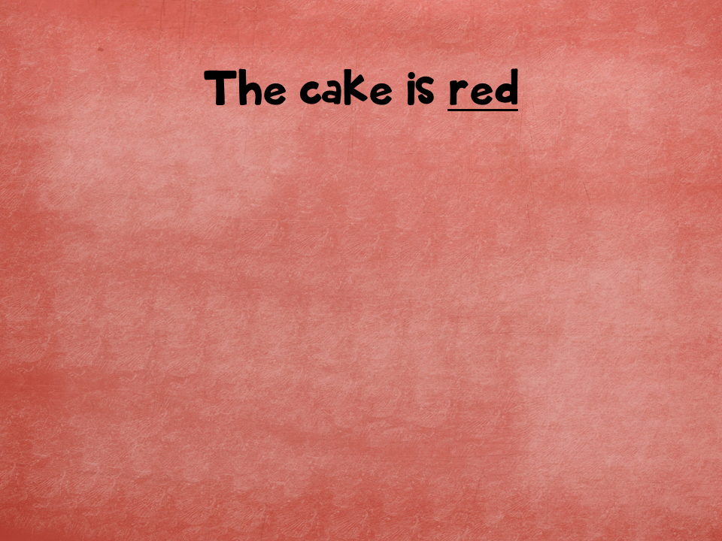
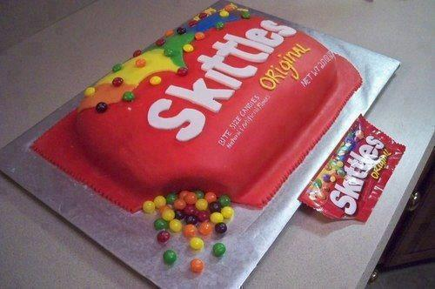
Physical Property
Notes:
Physical property

Slide 34
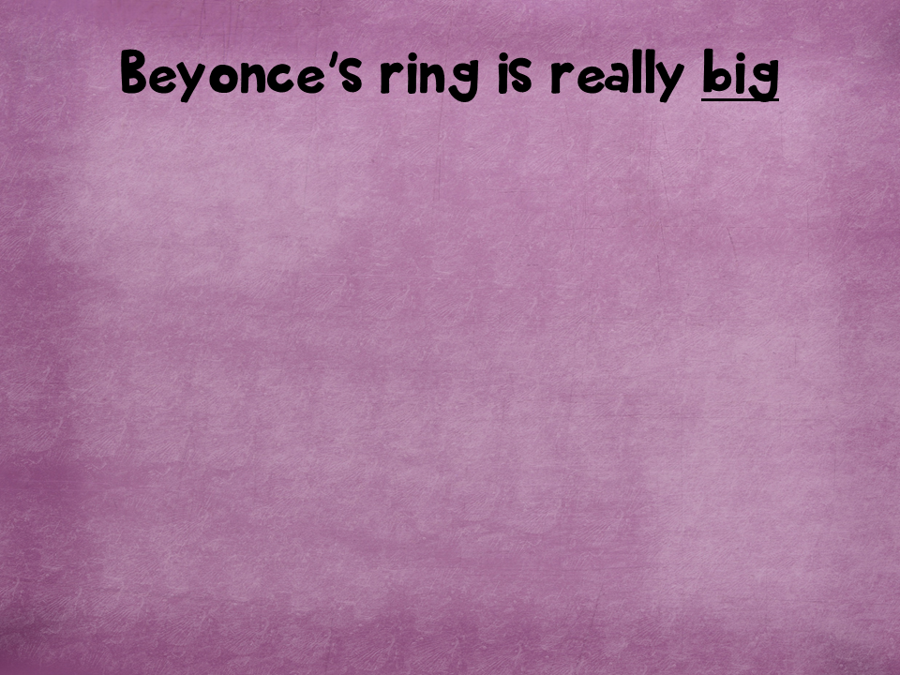

Physical Property
Notes:
Physical property

Slide 35

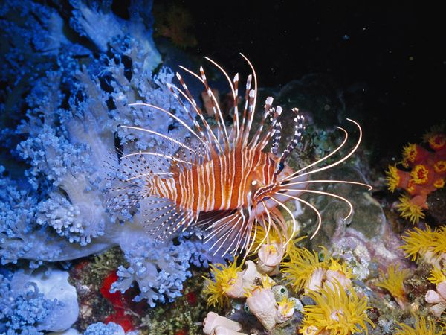
FYI: A sting from a lionfish is extremely painful to humans & can cause nausea and breathing problems
Chemical Property
Notes:
Chemical property

Slide 36

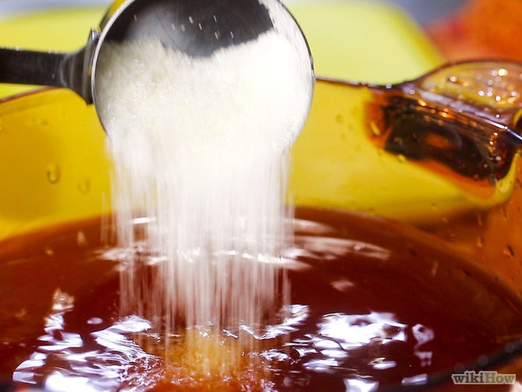
Dissolving sugar in water to make sweet tea
Physical Property
Notes:
Physical property

Slide 37
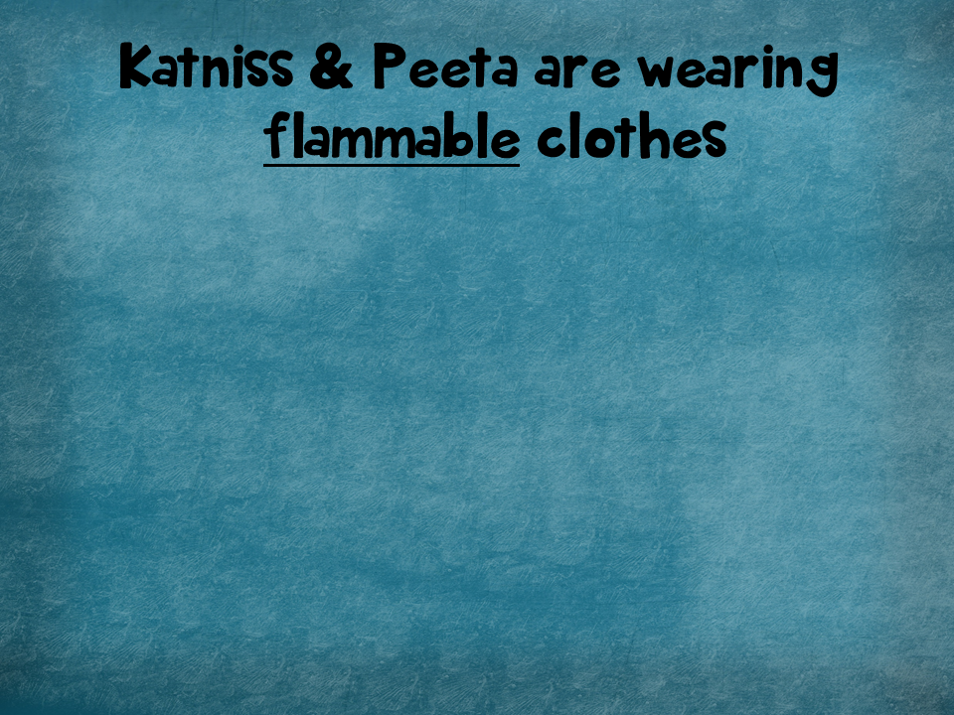

Chemical Property
Notes:
Chemical property

Slide 38


Chemical Property
Notes:
Chemical property

Slide 39
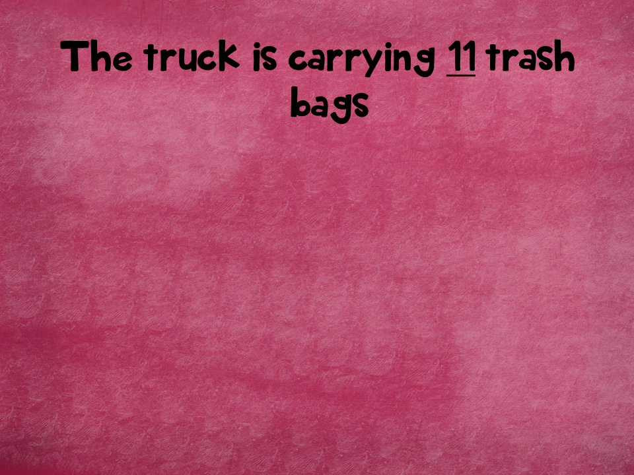
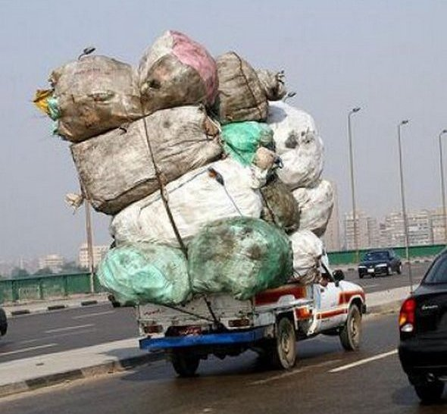
Physical Property
Notes:
Physical property

Slide 40
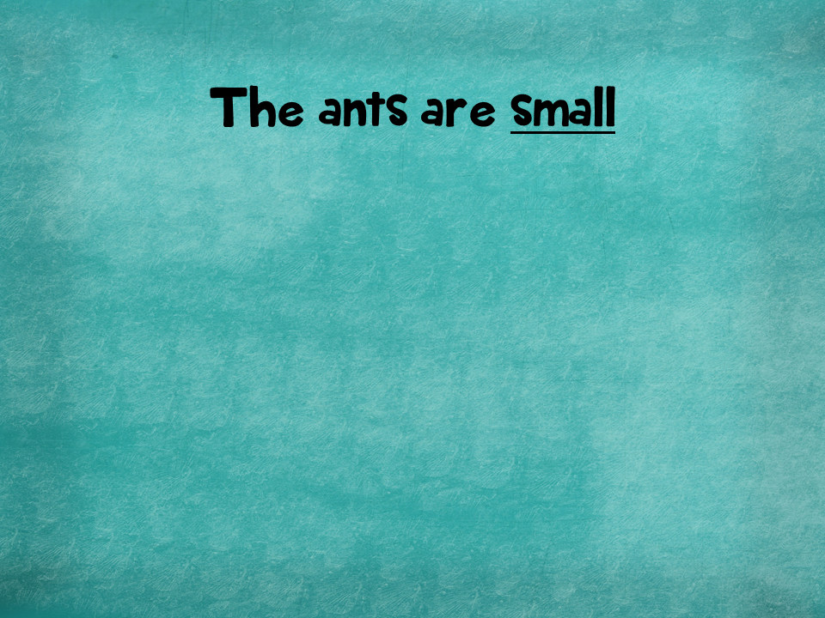
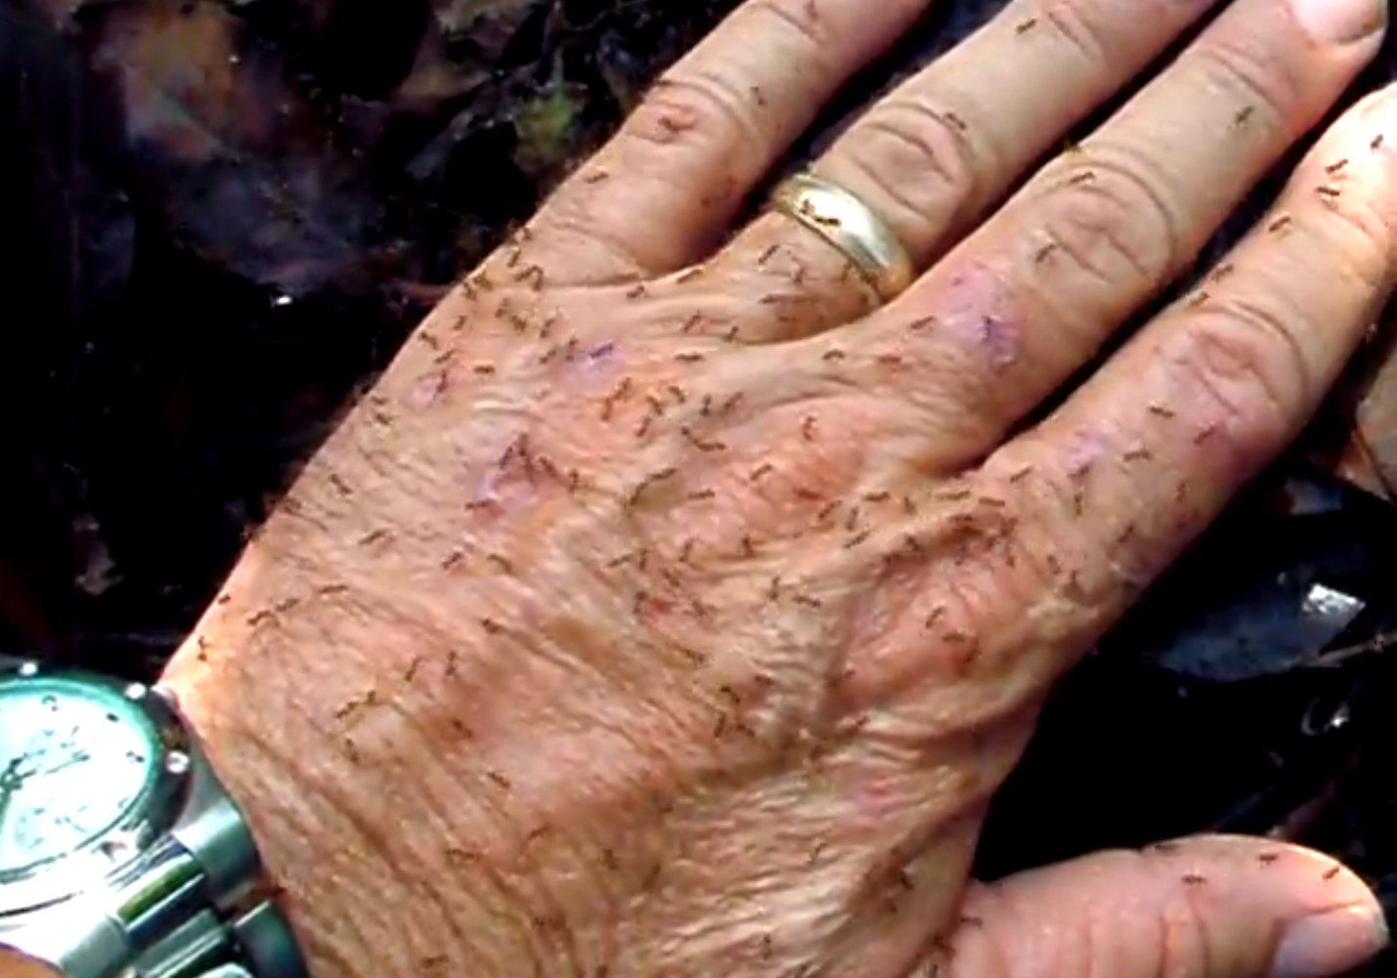
Physical Property
Notes:
Physical property

Slide 41
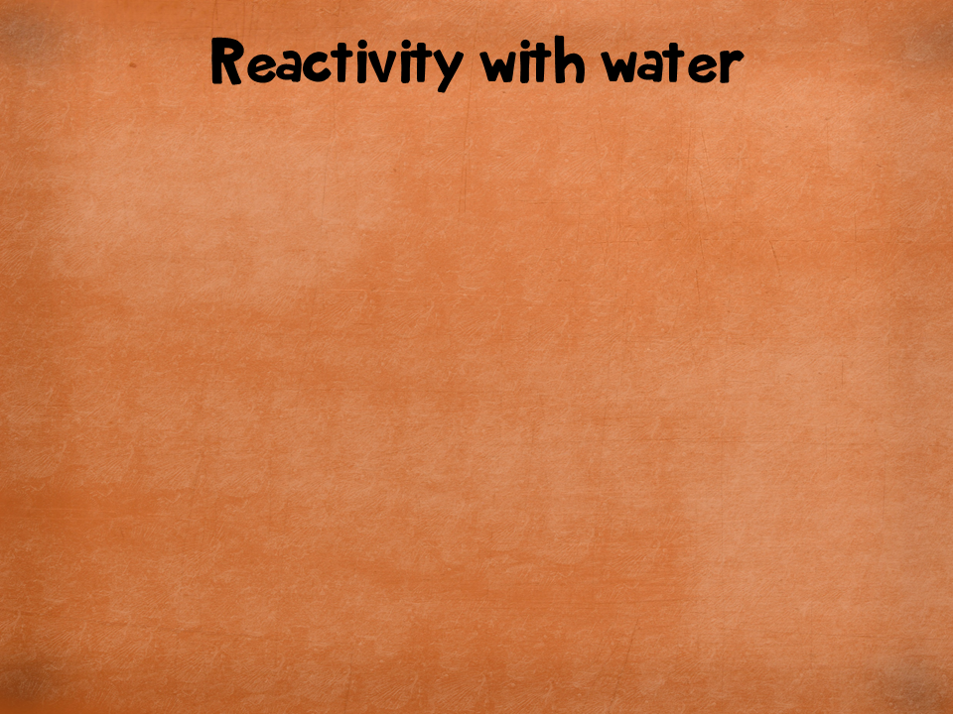
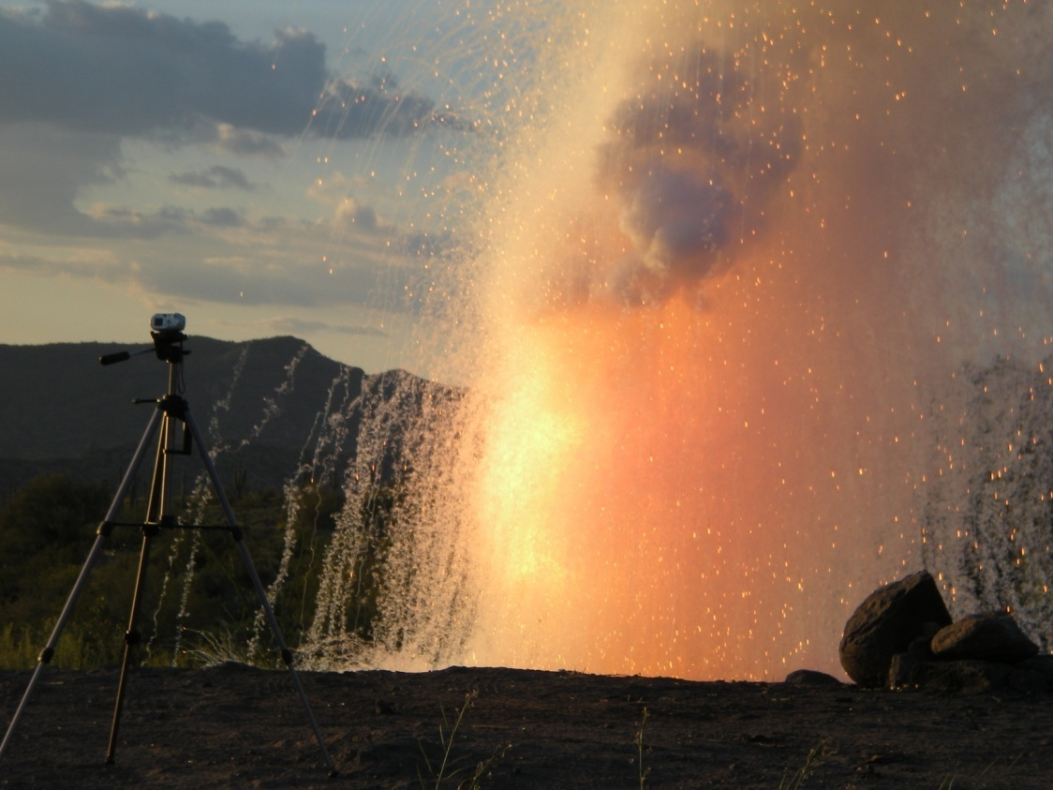
FYI: This is sodium reacting with water…and igniting hydrogen gas
Chemical Property
Notes:
Chemical property

Slide 42

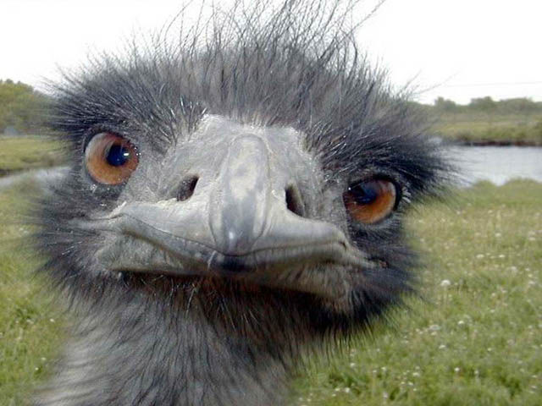
Physical Property
Notes:
Physical property

Slide 43
Match the following definitions with the correct property.
k
Conductivity
Ductility
Flammability
Hardness
Luster
Malleability
Oxidation
Reactivity with water
Sensitivity to light
Solubility
Toxicity
A resistance to being scratched or dented.
The ability to reflect light.
The ability to be stretched into wires.
The ability to catch on fire.
The ability to be hammered into a flat sheet.
The ability to react with water.
The ability to dissolve in a liquid.
The ability to be poisonous.
The ability to react with oxygen.
The ability to change when exposed to light.
The ability to pass electricity or heat through a substance.
c
d
Properties
Definitions
a
b
e
i
f
j
g
h
Notes:
1) K 2) C 3) D 4) A 5) B 6) E 7) I 8) F 9) J 10) G 11) H

Slide 44
Hydrogen | B | Zn | Fluorine | Silicon
Magnesium | Ca | Lithium | S | Cu
Ar | Carbon | Gold | N | Fe
Be | Silver | O | Al | Neon
Potassium | Sodium | P | He | Chlorine
Chemical Symbol Refresher:
All you need to do is write out the chemical symbol for the elements name or vice versa. Use your periodic table to help you!
You need to correctly identify 5 lines to win this Bingo challenge!

Slide 45
H | Boron | Zinc | F | Si
Mg | Calcium | L | Sulfur | Copper
Argon | C | Au | Nitrogen | Iron
Beryllium | Ag | Oxygen | Aluminium | Ne
K | Na | Phosphorus | Helium | Cl
Chemical Symbol Refresher:
All you need to do is write out the chemical symbol for the elements name or vice versa. Use your periodic table to help you!

Slide 46
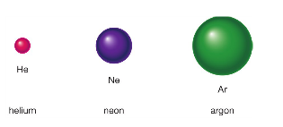
Monoatomic Elements
An element that consists of just single atom is known as monoatomic.
These are rare, only 6!
These are the noble gases in group 18
Helium, Neon, Argon, Krypton, Xenon and Radon
All are non-metallic gases

Slide 47
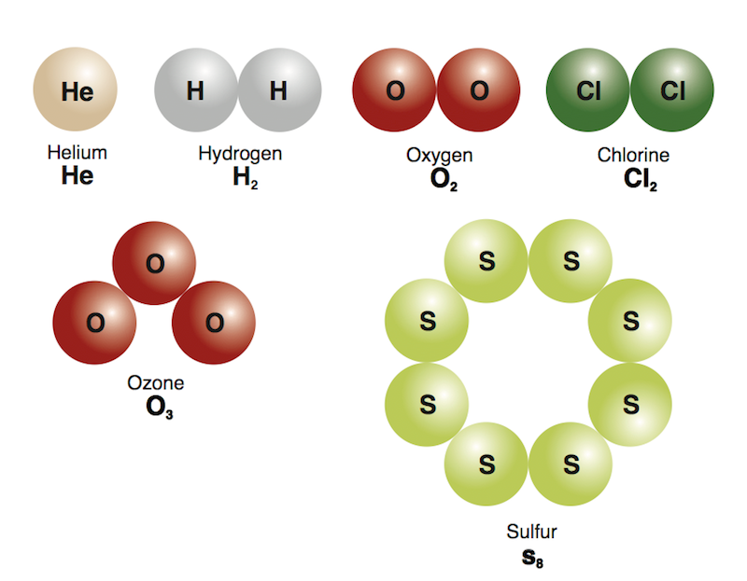
Molecular Elements
Molecules are two or more atoms bonded together
In a molecular element, all the molecules are identical with the same size, shape, number and type of atom.
CHECK FOR UNDERSTANDING
Oxygen gas is a molecular element. True or False?

Slide 48
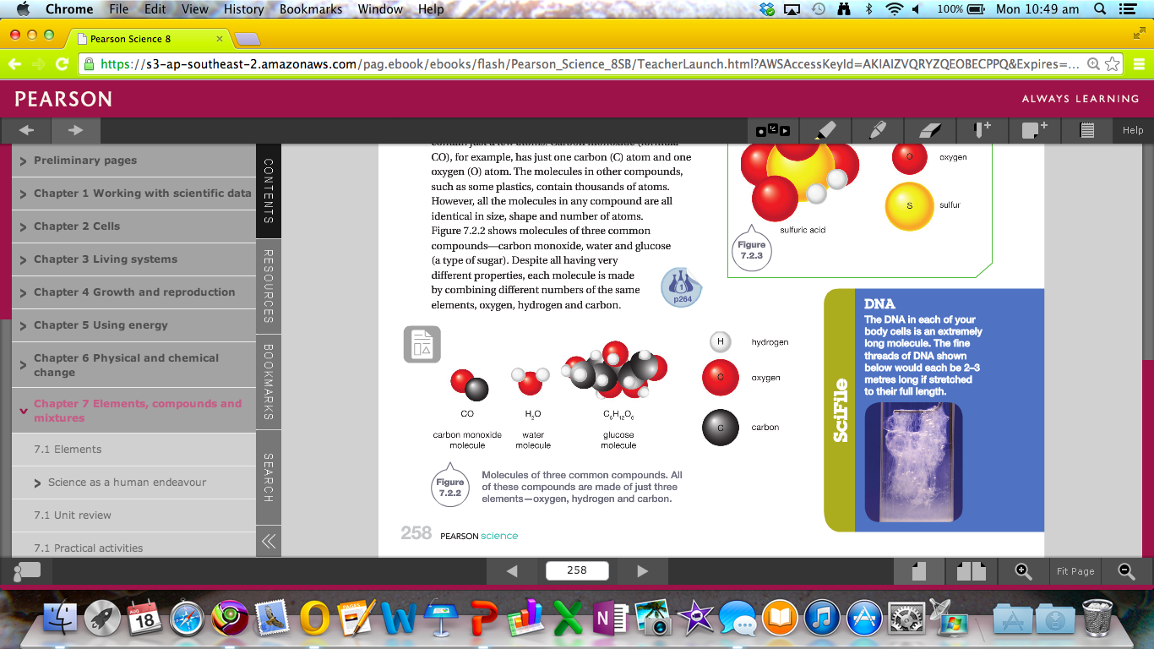
Molecular Compound
Molecular compounds contain cluster of atoms of different types.
Sugar is made up of 6 carbon atoms, 12 hydrogen atoms and 6 oxygen atoms.
Water is made up of 2 hydrogen atoms and 1 oxygen atom.
CHECK FOR UNDERSTANDING
Is carbon dioxide a molecular compound or molecular elements?

Slide 49
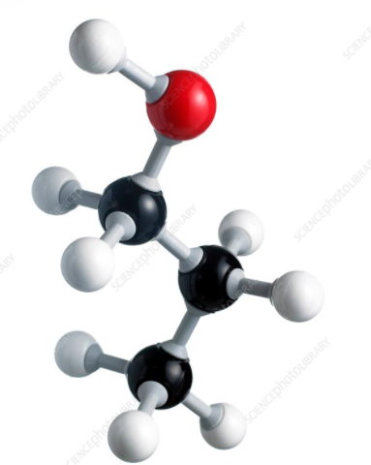
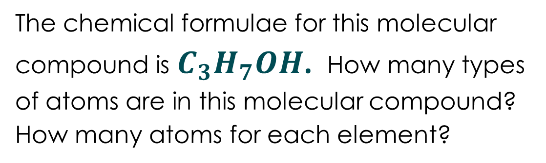
The chemical formulae for this molecular compound is $C_{3}H_{7}OH$. How many types of atoms are in this molecular compound? How many atoms for each element?
Elements | Number of Atoms

Slide 50
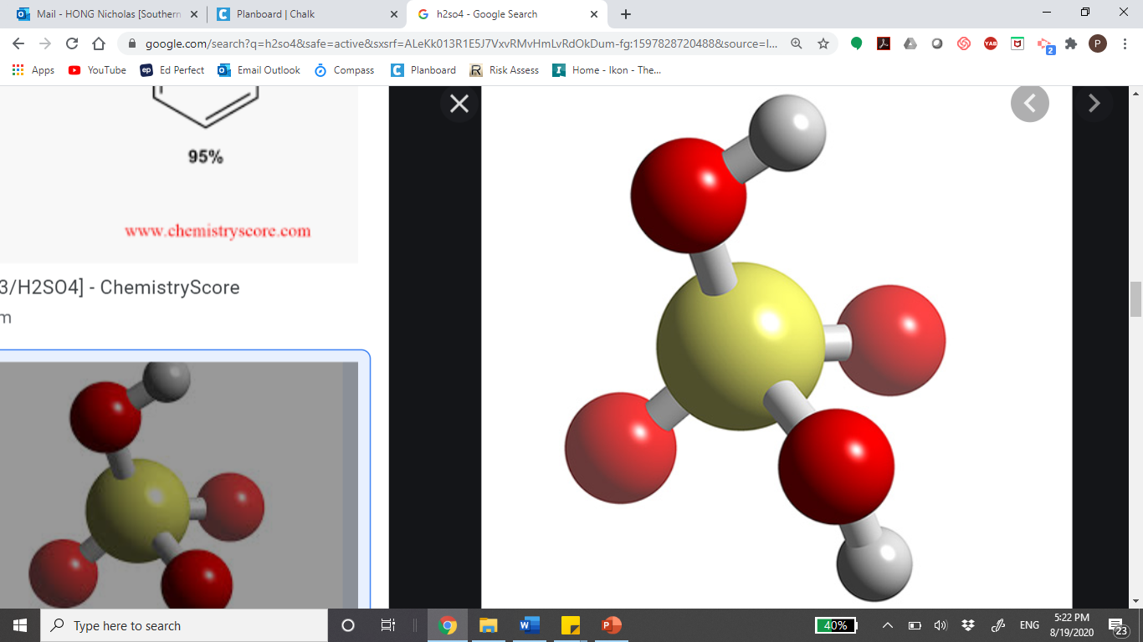
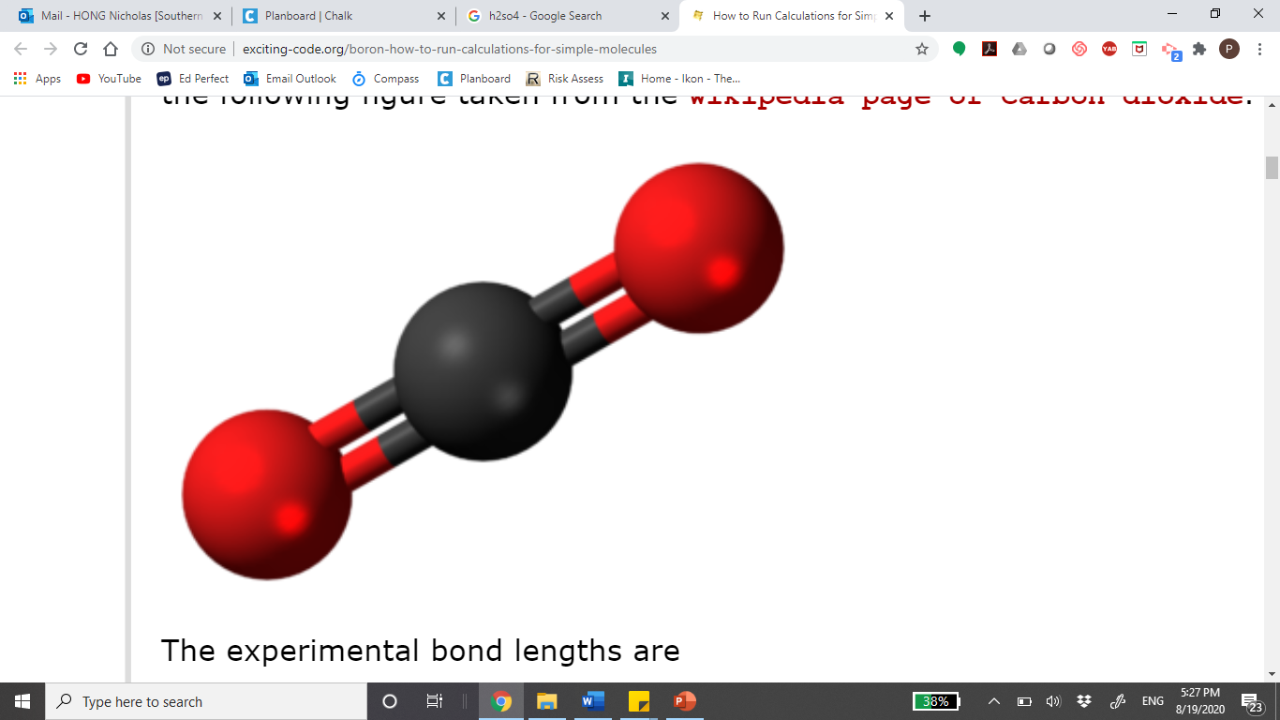
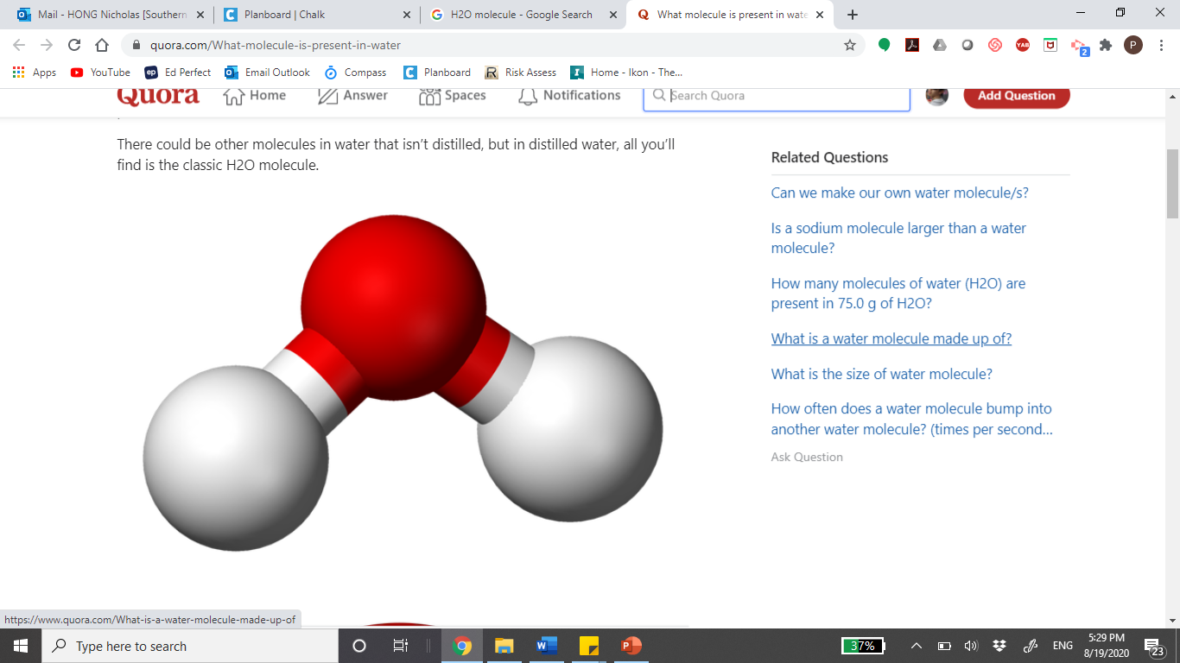



How many types of atoms are in this molecular compound?
How many atoms altogether in total?
$$H_{2}{SO}_{4}$$
$${CO}_{2}$$
$$H_{2}O$$

Slide 51
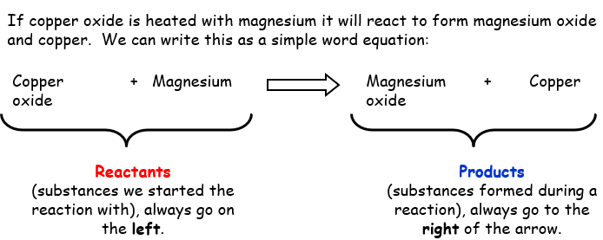
Components of a Word Equation

Slide 52
Writing a Chemical Word Equation
Heating calcium carbonate will cause it to decompose into calcium oxide and carbon dioxide gas.
Burning carbon in oxygen will create carbon dioxide gas.

Slide 53
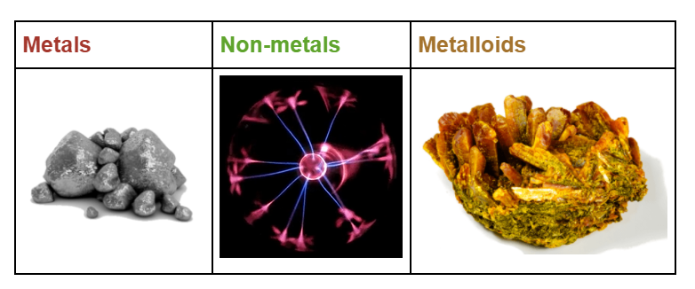
Types of Elements on the Periodic Table
Notes:
8.11

Slide 54
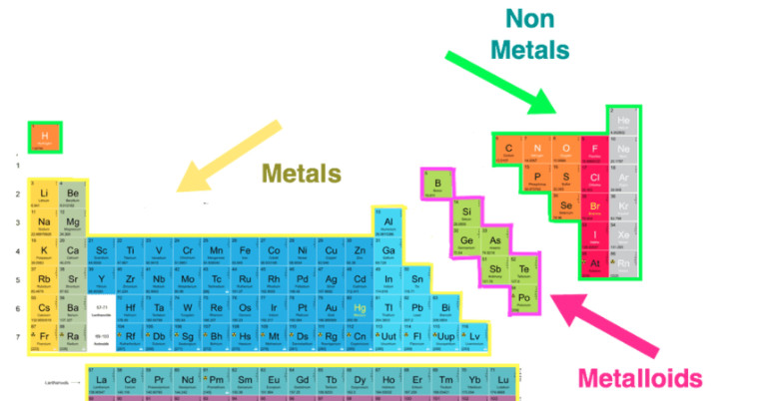
Types of Elements on Periodic Table

Slide 55
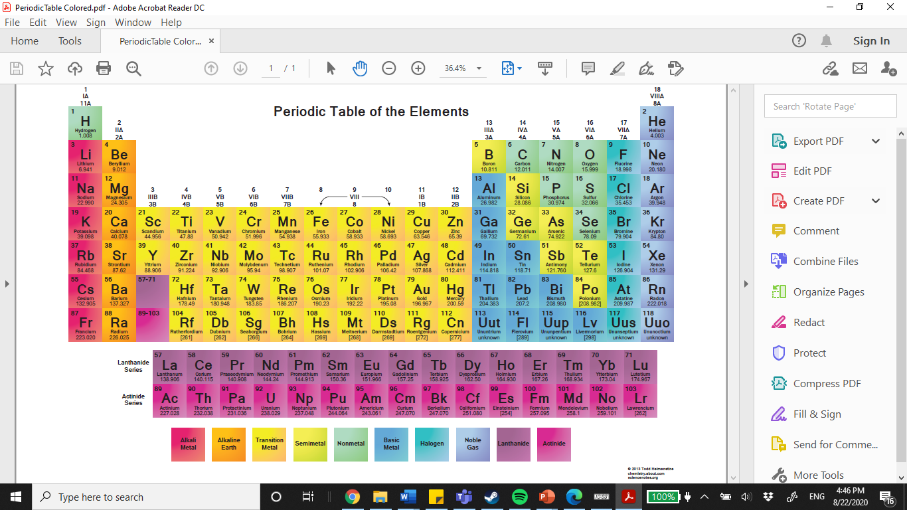
Types of elements on periodic Table

Slide 56
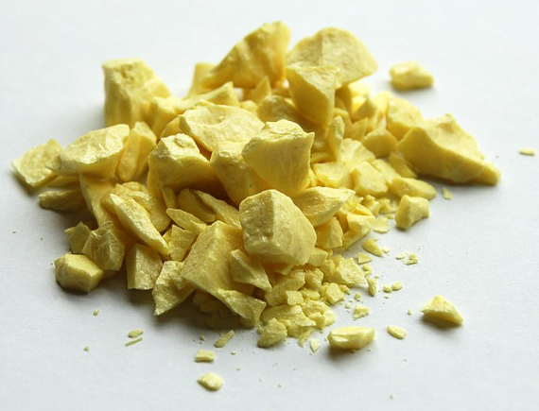
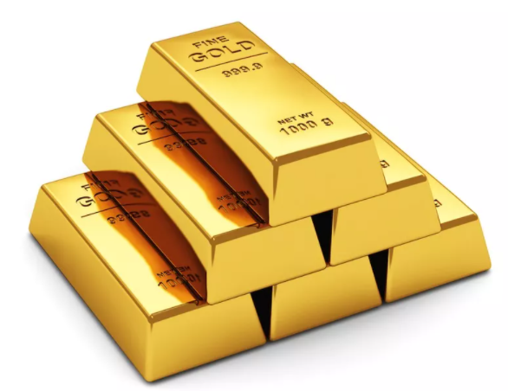
Metals and Non metals
Metals generally have the following characteristics:
Lustrous
Malleable
Ductile
Solid at room temperature
Good conductors of heat and electricity
Non-metals generally have the following characteristics:
Dull (opposite to Lustrous)
Brittle (not malleable)
Low melting points (lower than metals)
Poor conductors of heat and electricity

Slide 57






Alloy Formation
Alloy is formed by combining one metallic element with another one metallic or non-metallic element.
Combining the metallic elements gold and copper produces red gold
Combining gold and silver becomes white gold
Combining silver and copper produces sterling silver.

Slide 58

Arrangement of Elements in Pure Metal vs Alloy
Notes:
8.11

Slide 59

Identify the structure of alloy vs pure metals
Notes:
8.11

Slide 60


MAKE THE CONNECTION
Bread, cakes and eggs can't be "uncooked." Toast can't be "unburned!“
Identifying irreversible reaction

Slide 61
Physical Change vs Chemical Change
A physical change is a change in which molecules may be rearranged but their internal structure has not been
affected. In other words, no new substance was formed
on a molecular level.
During a physical change the matter may change size, shape, or form.
In many cases, a physical change CAN be undone or reversed.
A chemical change is a change in which a NEW substance is produced. During a chemical change the matter changes on a
molecular level. Atomic bonds are broken, and new ones are formed.
Unlike a physical change, chemical changes CANNOT be
undone.

Slide 62



Slide 63


Slide 64


Slide 65


Slide 66


Slide 67


Slide 68


Slide 69


Slide 70


Slide 71


Slide 72


